Slide 1

Layout Managers/Choices
CSE 205 : Fall 2017

Slide 2

11.1 Layout Management
Arranging components on the screen
User-interface components are arranged by placing them in a Swing Container object:
JFrame (content pane), JPanel
So far, all components have been arranged from left to right inside a Jpanel container
https://docs.oracle.com/javase/tutorial/uiswing/layout/visual.html

Slide 3
Layout Management
Each container has a layout manager that directs the arrangement of its components
Here is a list of commonly used layout managers: (they are defined in java.awt package.)
FlowLayout – it organizes components from left to right, starting new rows as necessary.
BorderLayout – it organizes components into five areas (North, South, East, West, and Center).
GridLayout – it organizes components into a grid of rows and columns
BoxLayout – it organizes components into a single row or a single column.
CardLayout – it organizes components into one such that only one is visible at any time.
GridBagLayout – it organizes components into a grid of cells, allowing components to span more than one cell.
Components are added to a container which uses a layout manager to place them

Slide 4
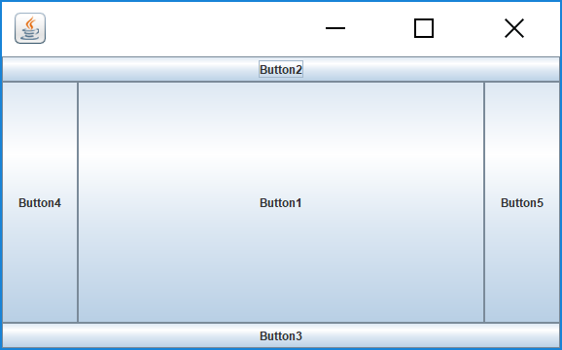
An Example of using BorderLayout
JPanel panel = new JPanel();
panel.setLayout(new BorderLayout());
// create five buttons
JButton button1 = new JButton("Button1");
JButton button2 = new JButton("Button2");
JButton button3 = new JButton("Button3");
JButton button4 = new JButton("Button4");
JButton button5 = new JButton("Button5");
panel.add(button1, BorderLayout.CENTER);
panel.add(button2, BorderLayout.NORTH);
panel.add(button3, BorderLayout.SOUTH);
panel.add(button4, BorderLayout.WEST);
panel.add(button5, BorderLayout.EAST);
add(panel);
https://docs.oracle.com/javase/tutorial/uiswing/layout/border.html

Slide 5
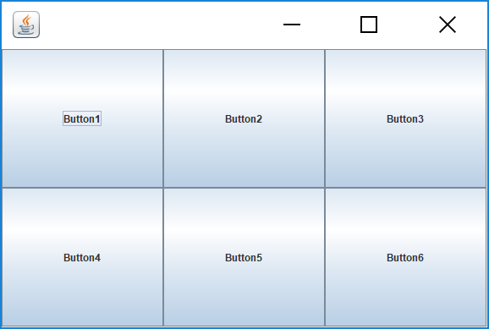
An Example of using GridLayout
It will fill the first row from left to right first, then fill the second
row, and so on. Here we have only five components to add, so the
last slot is empty and it is showing its background color – gray,
the default color for the content pane.
JPanel panel = new JPanel();
panel.setLayout(new GridLayout(2,3));
// create five buttons
JButton button1 = new JButton("Button1");
JButton button2 = new JButton("Button2");
JButton button3 = new JButton("Button3");
JButton button4 = new JButton("Button4");
JButton button5 = new JButton("Button5");
JButton button6 = new JButton("Button6");
panel.add(button1);
panel.add(button2);
panel.add(button3);
panel.add(button4);
panel.add(button5);
panel.add(button6);

Slide 6
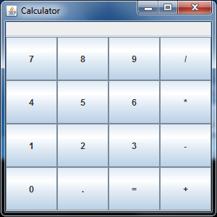
Using Layout Managers : Calculator Example
CalculatorViewer_GridExample.zip

Slide 7
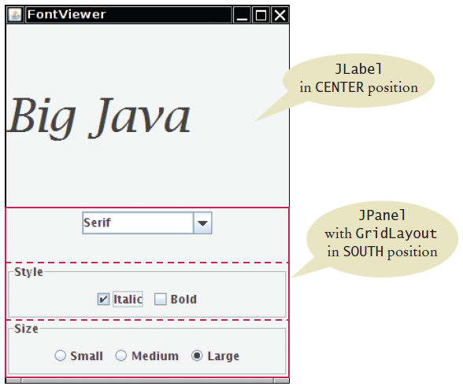
FontViewer Layout
Title Bar
Label
Shows
current font
Combo Box
Check Boxes
Radio Buttons
FontViewerExample.zip

Slide 8



11.2 Choices
In a modern graphical user interface program, there are commonly used devices to make different types of selections:
Radio Buttons
For a small set of mutually exclusive choices
Check Boxes
For a binary choice
Combo Boxes
For a large set of choices

Slide 9
Radio Button Panels
Use a panel for each set of radio buttons
The default border for a panel is invisible (no border)
You can add a border to a panel to make it visible along with a text label:
There are a large number of border styles available
See the Swing documentation for more details
JPanel panel = new JPanel();
panel.add(smallButton);
panel.add(mediumButton);
panel.add(largeButton);
panel.setBorder(new TitledBorder(new EtchedBorder(),"Size"));

Slide 10
Grouping Radio Buttons
Add Radio Buttons into a ButtonGroup so that only one button in the group is selected at a time
Create the JRadioButtons first, then add them to the ButtonGroup
Note that the button group does not place the buttons close to each other on the container
JRadioButton smallButton = new JRadioButton("Small");
JRadioButton mediumButton = new JRadioButton("Medium");
JRadioButton largeButton = new JRadioButton("Large");
ButtonGroup group = new ButtonGroup();
group.add(smallButton);
group.add(mediumButton);
group.add(largeButton);

Slide 11
Selecting Radio Buttons
It is customary to set one button as selected (the default) when using radio buttons
Use the button's setSelected method
Set the default button before making the enclosing frame visible
Call the isSelected method of each button to find out which one it is currently selected
JRadioButton largeButton = new JRadioButton("Large");
largeButton.setSelected(true);
if (largeButton.isSelected())
{ size = LARGE_SIZE; }

Slide 12
Check Boxes versus Radio Buttons
Radio buttons and check boxes have different visual appearances
Radio buttons are round and
show a black dot when selected
Check boxes are square and
show a check mark when selected

Slide 13
Check Boxes
A check box is a user-interface component with two states: checked and unchecked
Use for choices that are not mutually exclusive
For example, text may be Italic, Bold, both or neither
Because check box settings do not exclude each other, you do not need to place a set of check boxes inside a button group

Slide 14
Selecting Check Boxes
To setup a Check Box, use Swing JCheckBox
Pass the constructor the name for the check box label
Call the isSelected method of a checkbox to find out whether it is currently selected or not
JCheckBox italicCheckBox = new JCheckBox("Italic");
if (italicCheckBox.isSelected())
{ style = style + Font.ITALIC }

Slide 15
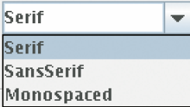
Combo Boxes
A combo box is a combination of a list and a text field
Use a combo box for a large set of choices
Use when radio buttons would take up too much space
It can be either:
Closed (shows one selection)
Open, showing multiple selections
It can also be editable
Type a selection into a blank line
When you click on the arrow to the right of the text field of a combo box, a list of selections drops down, and you can choose one of the items in the list
facenameCombo.setEditable();

Slide 16
Adding and Selecting Items
Add text ‘items’ to a combo box that will show in the list:
Use the getSelectedItem method to return the selected item (as an Object)
Combo boxes can store other objects in addition to strings, so casting to a string may be required:
JComboBox facenameCombo = new JComboBox();
facenameCombo.addItem("Serif");
facenameCombo.addItem("SansSerif");
. . .
String selectedString = (String) facenameCombo.getSelectedItem();

Slide 17
Lecture Review Programming Assignments GUI Activity 1: Due by Wednesday 27th 11:59 pm GUI Activity 2: Due by Friday 29th 11:59 pm

